Slide 1
Sampling Distributions
Chapter 8

Slide 2
Chapter 8
This chapter takes what we have covered so far – particularly random variables, expectation, and distributions – and lays the foundation for inference. I mentioned during the first day of class that this course is divided into two parts: probability theory and inference. Chapter 8 is the transition between the two parts.
8.1-8.2 introduce the way we think of data in terms of random variables and go over some basic statistics (similar to what we saw in chapter 1). 8.3 introduces the idea of a sampling distribution. Then 8.4-8.5 cover specific sampling distributions. Finally, we will introduce the t-distribution in 8.6.

Slide 3
8.1 – Random Sampling
In this section, we return to some of the same ideas we discussed in chapter 1. This time, however, we view them in light of what we have learned so far in the course.
The key thing to get from this section is to understand what we mean by random samples in terms of random variables. Everything we will do with inference in this class depends on having a random sample.

Slide 4
8.1 – Random Sampling
Recall the definitions of population and sample:
  A population consists of all the possible observations with which we are concerned.
  A sample is a subset of the population.
Remember also that we said the goal of statistical inference is to use information (data) from the sample to understand the population.

Slide 5
8.1 – Random Sampling
We mentioned also in chapter 1 that nonrandom (convenience) sampling methods are often biased. That is, statistics from such samples either consistently over- or under-estimate the true population parameters.
In order to eliminate this bias, we said that we need random sampling methods.

Slide 6
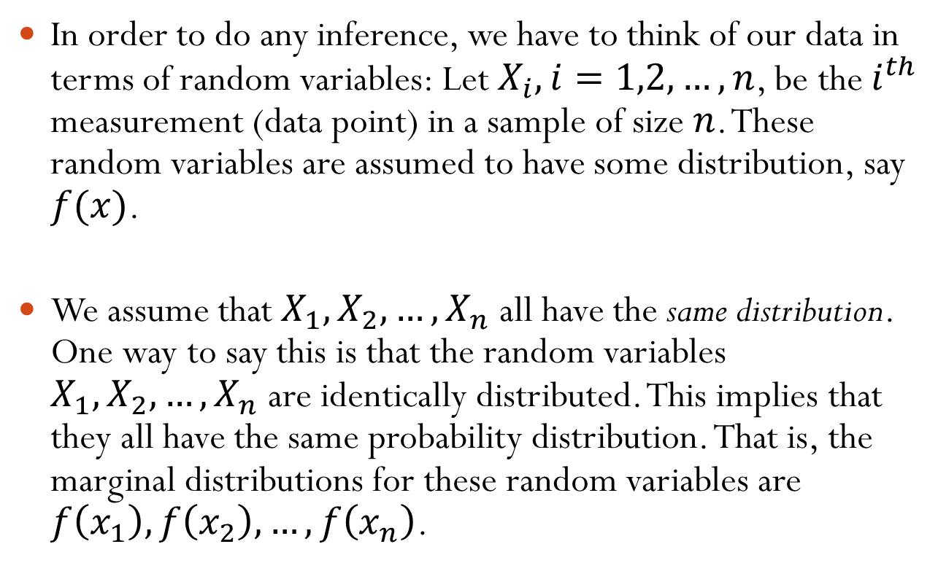
8.1 – Random Sampling
In order to do any inference, we have to think of our data in terms of random variables: Let $X_{i}, i=1,2,…,n$, be the $i^{th}$ measurement (data point) in a sample of size $n$. These random variables are assumed to have some distribution, say $f(x)$.
We assume that $X_{1}, X_{2}, …, X_{n}$ all have the same distribution. One way to say this is that the random variables $X_{1}, X_{2}, …, X_{n}$ are identically distributed. This implies that they all have the same probability distribution. That is, the marginal distributions for these random variables are $f\left(x_{1}\right), f\left(x_{2}\right), …, f\left(x_{n}\right)$.

Slide 7
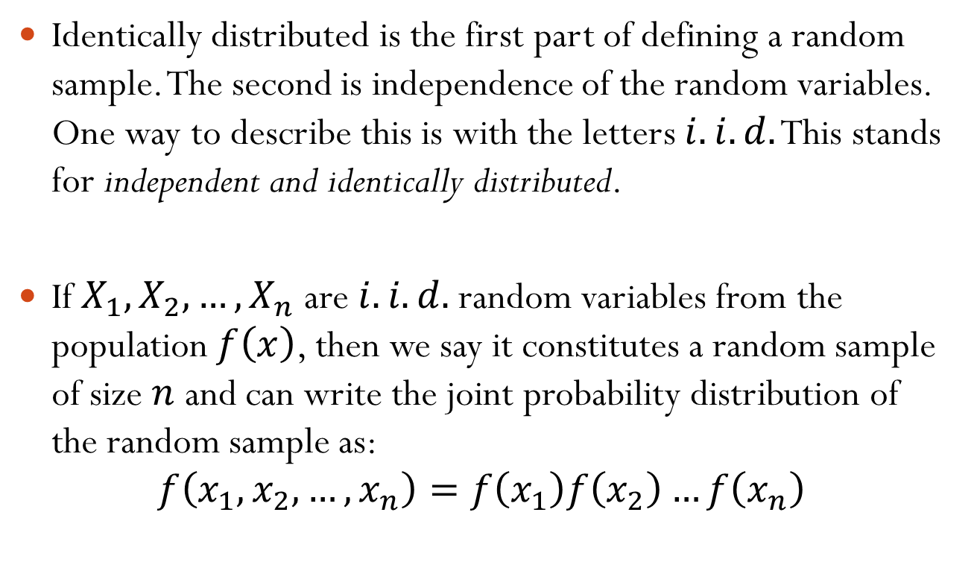
8.1 – Random Sampling
Identically distributed is the first part of defining a random sample. The second is independence of the random variables. One way to describe this is with the letters $i.i.d.$ This stands for independent and identically distributed.
If $X_{1}, X_{2}, …, X_{n}$ are $i.i.d.$ random variables from the population $f\left(x\right)$, then we say it constitutes a random sample of size $n$ and can write the joint probability distribution of the random sample as:
$$f\left(x_{1},x_{2},…,x_{n}\right)=f\left(x_{1}\right)f\left(x_{2}\right)…f\left(x_{n}\right)$$

Slide 8
8.2 – Important Descriptive Statistics
After we have collected a random sample, the first step in making an inference is to calculate a statistic. The idea is we need to understand the information in the sample so that we can apply it back to the population.
In chapter 1, we defined a statistic to be a numerical measure of a sample. Now that we have defined a random sample in terms of random variables, we can introduce a somewhat more technical definition of a statistic.

Slide 9
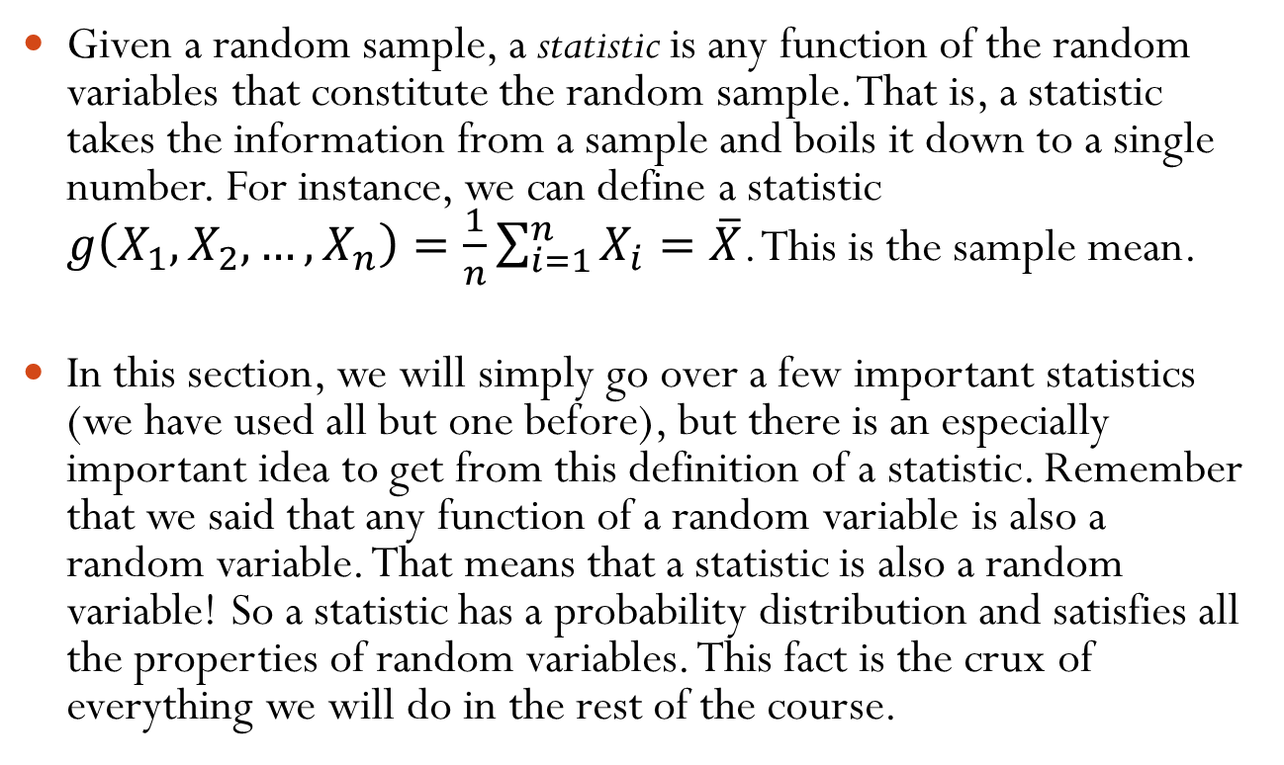
8.2 – Important Descriptive Statistics
Given a random sample, a statistic is any function of the random variables that constitute the random sample. That is, a statistic takes the information from a sample and boils it down to a single number. For instance, we can define a statistic $g\left(X_{1}, X_{2}, …, X_{n}\right)=\frac{1}{n}\sum_{i=1}^{n}{X_{i}}=\overline{X}$. This is the sample mean.
In this section, we will simply go over a few important statistics (we have used all but one before), but there is an especially important idea to get from this definition of a statistic. Remember that we said that any function of a random variable is also a random variable. That means that a statistic is also a random variable! So a statistic has a probability distribution and satisfies all the properties of random variables. This fact is the crux of everything we will do in the rest of the course.

Slide 10
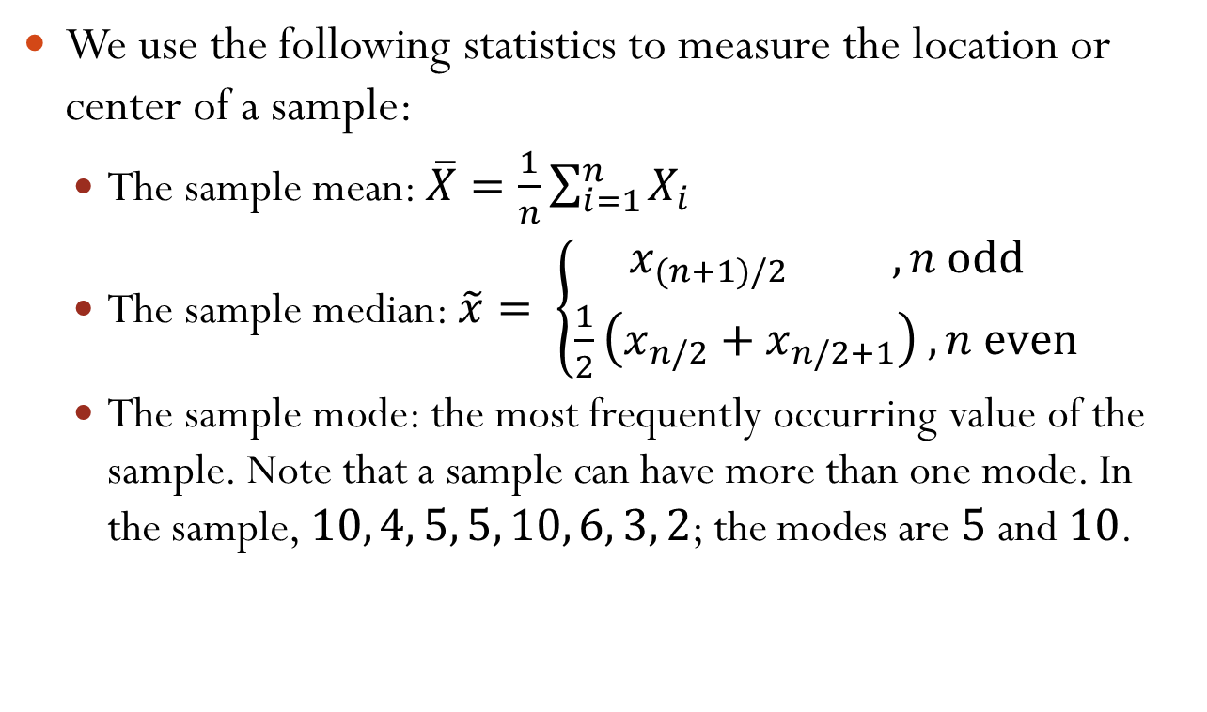
8.2 – Important Descriptive Statistics
We use the following statistics to measure the location or center of a sample:
  The sample mean: $\overline{X}=\frac{1}{n}\sum_{i=1}^{n}{X_{i}}$
  The sample median: $\tilde{x}= \left\{\begin{aligned}x_{(n+1)/2} , n odd \\ \frac{1}{2}\left(x_{n/2}+x_{n/2+1}\right) , n even\end{aligned} \right.$
  The sample mode: the most frequently occurring value of the sample. Note that a sample can have more than one mode. In the sample, $10, 4, 5, 5, 10, 6, 3, 2$; the modes are $5$ and $10$.

Slide 11
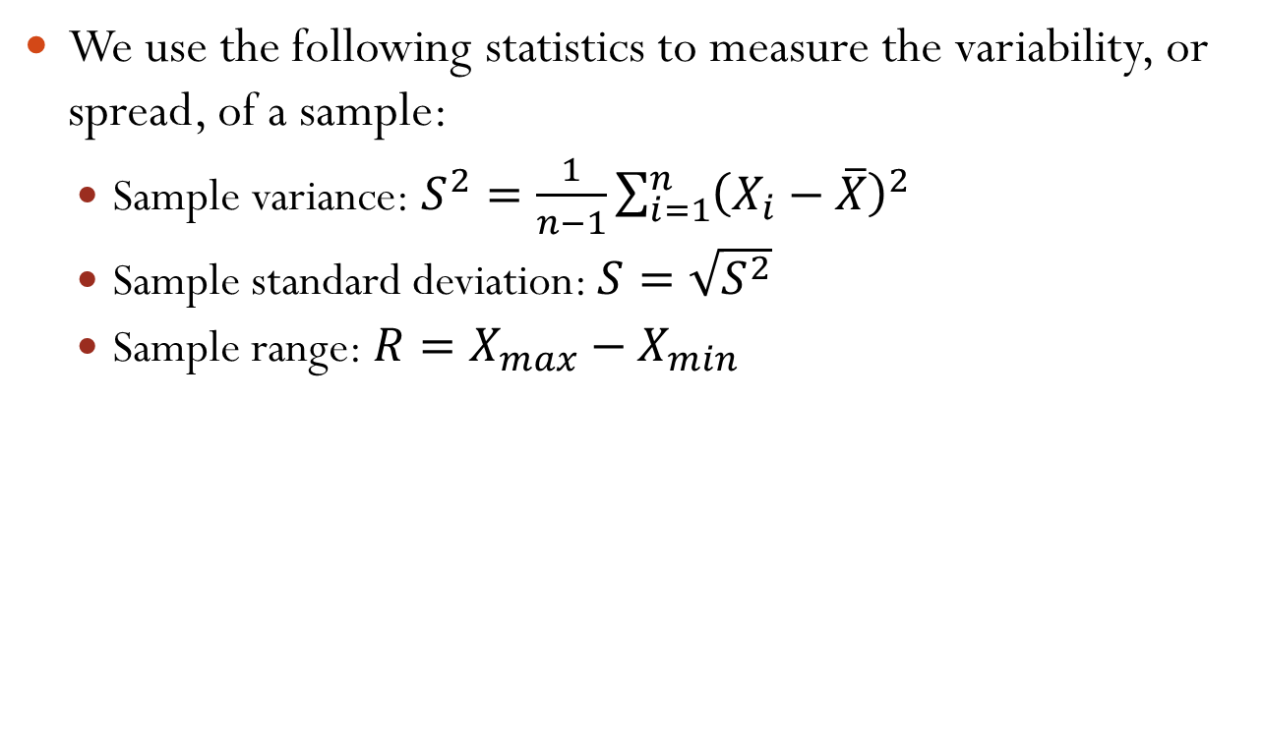
8.2 – Important Descriptive Statistics
We use the following statistics to measure the variability, or spread, of a sample:
  Sample variance: $S^{2}=\frac{1}{n−1}\sum_{i=1}^{n}{{\left(X_{i}−\overline{X}\right)}^{2}}$
  Sample standard deviation: $S=\sqrt{S^{2}}$
  Sample range: $R=X_{max}−X_{min}$

Slide 12
8.3 – Sampling Distributions
In 8.2, I mentioned that everything we will do during the rest of the course depends on the fact that a statistic is also a random variable. Again, this is because a statistic is a function of random variables.
The most important aspect of this for us is that because every statistic is a random variable, every statistic must also have a probability distribution. The probability distribution of a statistic is called a sampling distribution.

Slide 13
8.3 – Sampling Distributions
Different statistics have different sampling distributions. In 8.4, we will look at the sampling distribution for the sample mean. Then we will look at the sampling distribution for sample variance in 8.5.
As we will see, the sampling distribution of a statistic depends on the distribution of the population, the size of the samples, and how the samples are obtained.

Slide 14
8.3 – Sampling Distributions
Anytime we are doing any kind of statistical inference, we are concerned with two different probability distributions – the distribution of the population and the sampling distribution. To understand these, consider an example.
Suppose we want to know about the net income of Nebraskans – our population. We could define a random variable to be the net income for a Nebraskan. While it is probably not feasible to actually obtain all this information, the distribution of this random variable is the population distribution – the distribution of outcomes for the whole population.

Slide 15
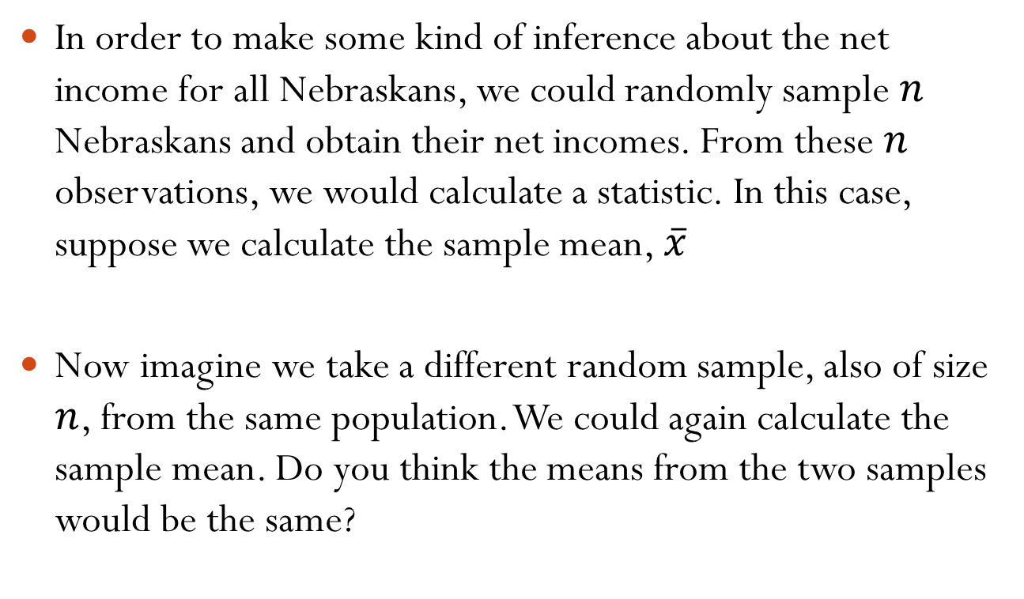
8.3 – Sampling Distributions
In order to make some kind of inference about the net income for all Nebraskans, we could randomly sample $n$ Nebraskans and obtain their net incomes. From these $n$ observations, we would calculate a statistic. In this case, suppose we calculate the sample mean, $\overline{x}$
Now imagine we take a different random sample, also of size $n$, from the same population. We could again calculate the sample mean. Do you think the means from the two samples would be the same?

Slide 16
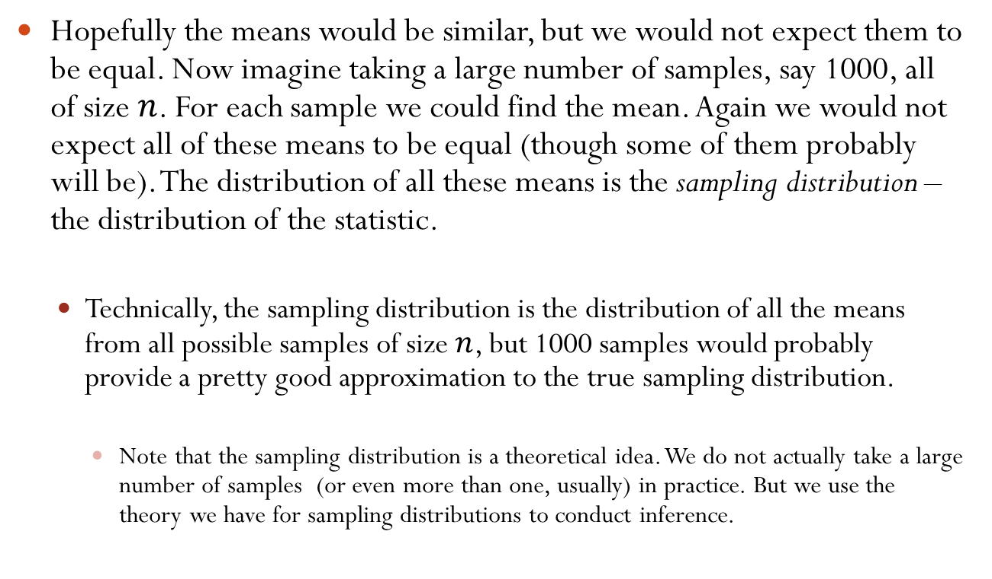
8.3 – Sampling Distributions
Hopefully the means would be similar, but we would not expect them to be equal. Now imagine taking a large number of samples, say 1000, all of size $n$. For each sample we could find the mean. Again we would not expect all of these means to be equal (though some of them probably will be). The distribution of all these means is the sampling distribution – the distribution of the statistic.
  Technically, the sampling distribution is the distribution of all the means from all possible samples of size $n$, but 1000 samples would probably provide a pretty good approximation to the true sampling distribution.
    Note that the sampling distribution is a theoretical idea. We do not actually take a large number of samples (or even more than one, usually) in practice. But we use the theory we have for sampling distributions to conduct inference.

Slide 17
8.3 – Sampling Distributions
As mentioned before, different statistics will have different sampling distributions, but the idea of a sampling distribution is the same for every statistic:
  If we take a large number of samples, all of the same size, from a population and then calculate a statistic (the same statistic) for each sample, the distribution of those statistics is the sampling distribution.

Slide 18
8.4 – Sampling Distribution of Means and the Central Limit Theorem
In this section we introduce the sampling distribution for the sample mean. We will also introduce one of the most important theorems in all of statistics: the Central Limit Theorem.
Both of these concepts will be invaluable for the chapters on inference.

Slide 19
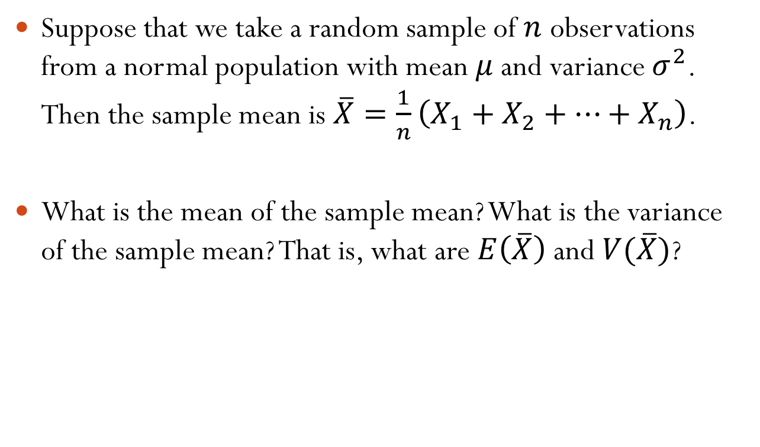
8.4 – Sampling Distribution of Means and the Central Limit Theorem
Suppose that we take a random sample of $n$ observations from a normal population with mean $μ$ and variance $σ^{2}$. Then the sample mean is $\overline{X}=\frac{1}{n}\left(X_{1}+X_{2}+…+X_{n}\right)$.
What is the mean of the sample mean? What is the variance of the sample mean? That is, what are $E\left(\overline{X}\right)$ and $V(\overline{X})$?

Slide 20
8.4 – Sampling Distribution of Means and the Central Limit Theorem
This tells us that if we take a random sample from a normal population, the sampling distribution of the mean is centered at the population mean, and the variance of the sampling distribution is simply the population variance divided by the sample size. As we will see, this is incredibly useful for inference.
This result can also be demonstrated using the Central Limit Theorem which we will soon go over.

Slide 21
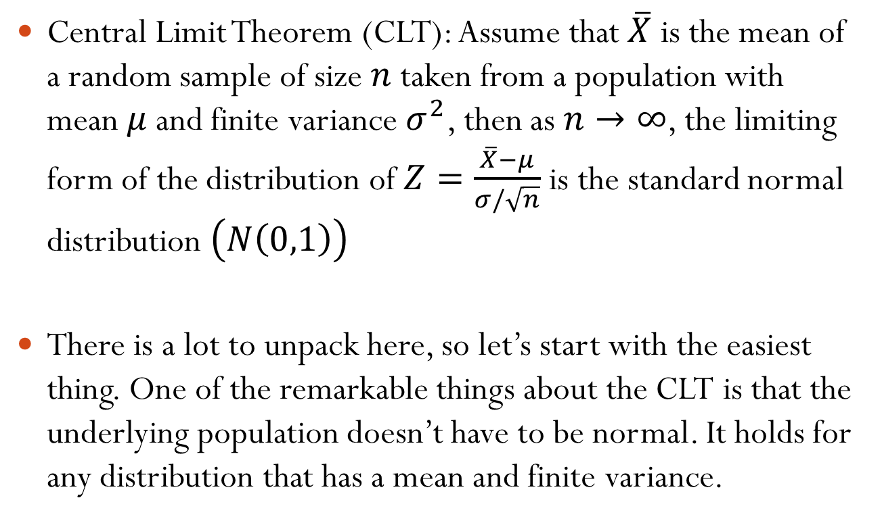
8.4 – Sampling Distribution of Means and the Central Limit Theorem
Central Limit Theorem (CLT): Assume that $\overline{X}$ is the mean of a random sample of size $n$ taken from a population with mean $μ$ and finite variance $σ^{2}$, then as $n→∞$, the limiting form of the distribution of $Z=\frac{\overline{X}−μ}{σ/\sqrt{n}}$ is the standard normal distribution $\left(N\left(0,1\right)\right)$
There is a lot to unpack here, so let’s start with the easiest thing. One of the remarkable things about the CLT is that the underlying population doesn’t have to be normal. It holds for any distribution that has a mean and finite variance.

Slide 22
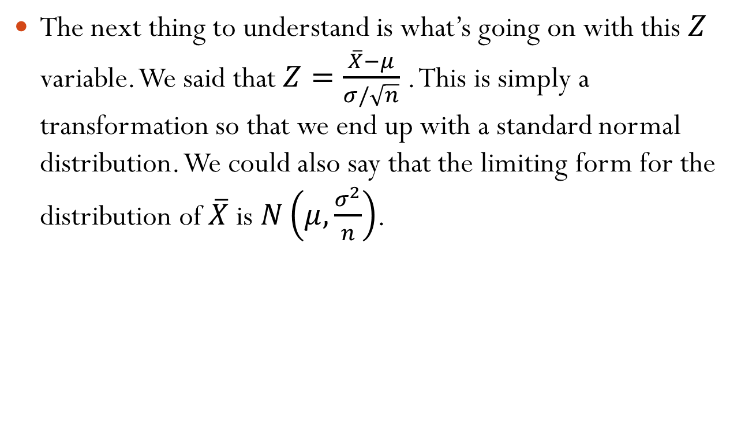
8.4 – Sampling Distribution of Means and the Central Limit Theorem
The next thing to understand is what’s going on with this $Z$ variable. We said that $Z=\frac{\overline{X}−μ}{σ/\sqrt{n}}$ . This is simply a transformation so that we end up with a standard normal distribution. We could also say that the limiting form for the distribution of $\overline{X}$ is $N\left(μ,\frac{σ^{2}}{n}\right)$.

Slide 23
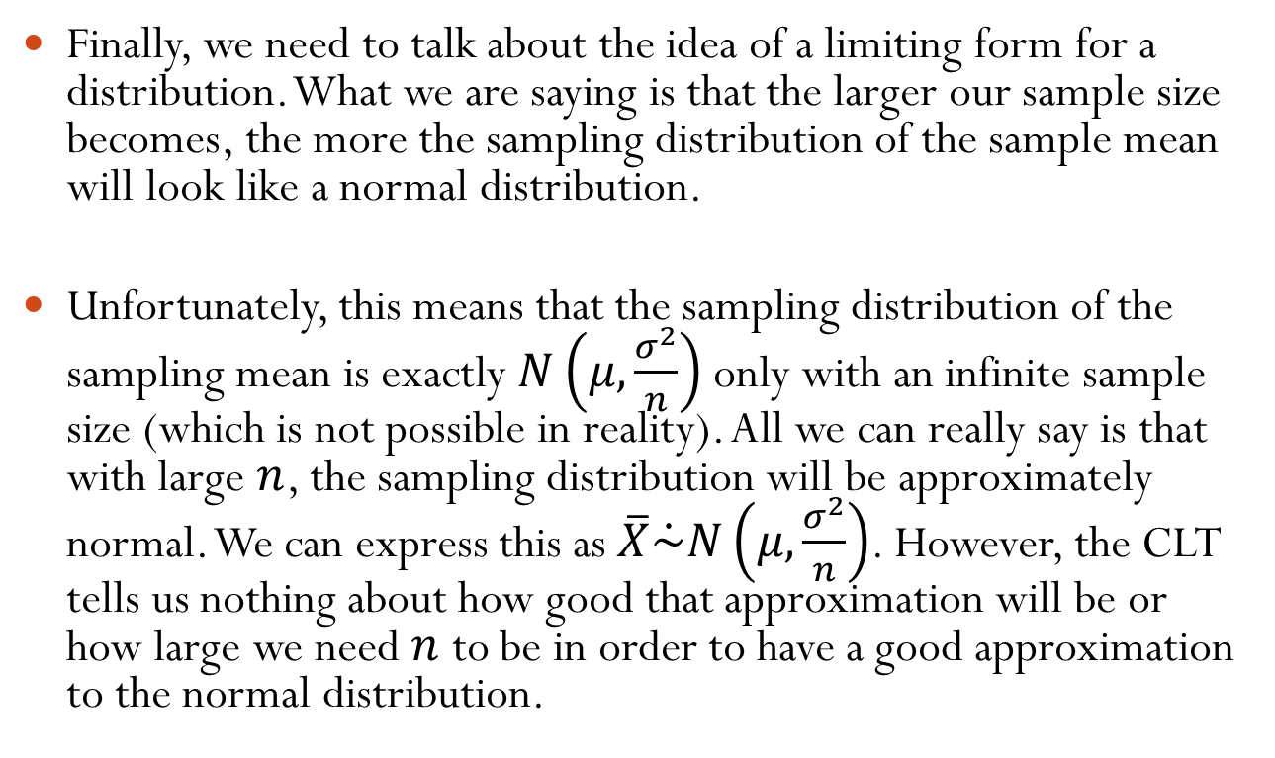
8.4 – Sampling Distribution of Means and the Central Limit Theorem
Finally, we need to talk about the idea of a limiting form for a distribution. What we are saying is that the larger our sample size becomes, the more the sampling distribution of the sample mean will look like a normal distribution.
Unfortunately, this means that the sampling distribution of the sampling mean is exactly $N\left(μ,\frac{σ^{2}}{n}\right)$ only with an infinite sample size (which is not possible in reality). All we can really say is that with large $n$, the sampling distribution will be approximately normal. We can express this as $\overline{X}\dot{\sim }N\left(μ,\frac{σ^{2}}{n}\right)$. However, the CLT tells us nothing about how good that approximation will be or how large we need $n$ to be in order to have a good approximation to the normal distribution.

Slide 24
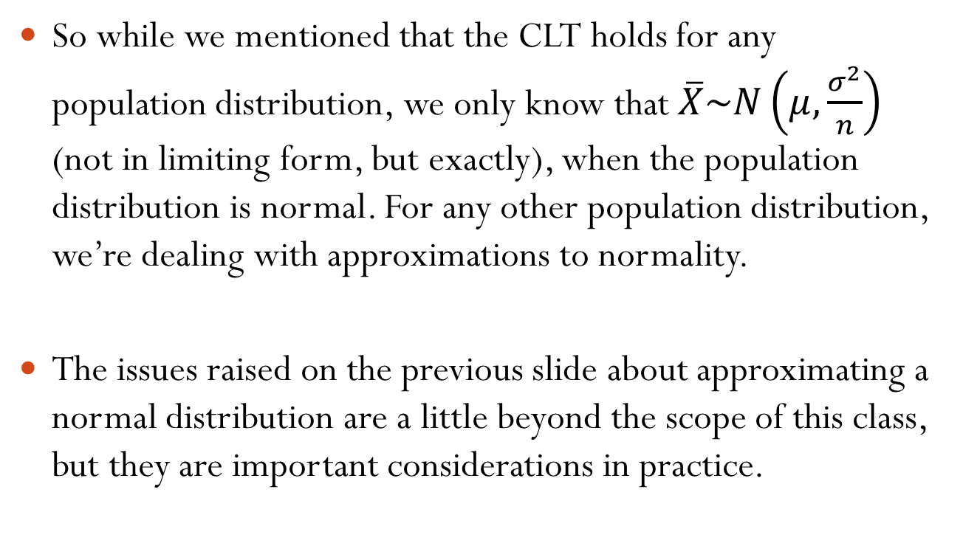
8.4 – Sampling Distribution of Means and the Central Limit Theorem
So while we mentioned that the CLT holds for any population distribution, we only know that $\overline{X}\sim N\left(μ,\frac{σ^{2}}{n}\right)$ (not in limiting form, but exactly), when the population distribution is normal. For any other population distribution, we’re dealing with approximations to normality.
The issues raised on the previous slide about approximating a normal distribution are a little beyond the scope of this class, but they are important considerations in practice.

Slide 25
8.4 – Sampling Distribution of Means and the Central Limit Theorem
So here’s the idea of the CLT: For any population distribution, the sampling distribution of the sample mean will look more and more like a normal distribution as the sample size gets larger and larger.

Slide 26
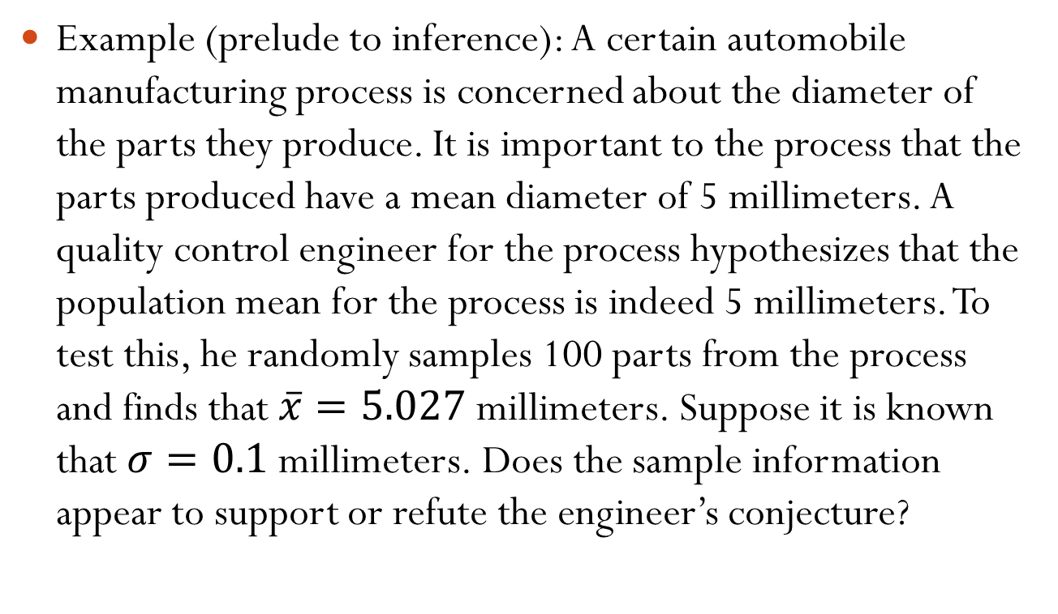
8.4 – Sampling Distribution of Means and the Central Limit Theorem
Example (prelude to inference): A certain automobile manufacturing process is concerned about the diameter of the parts they produce. It is important to the process that the parts produced have a mean diameter of 5 millimeters. A quality control engineer for the process hypothesizes that the population mean for the process is indeed 5 millimeters. To test this, he randomly samples 100 parts from the process and finds that $\overline{x}=5.027$ millimeters. Suppose it is known that $σ=0.1$ millimeters. Does the sample information appear to support or refute the engineer’s conjecture?

Slide 27
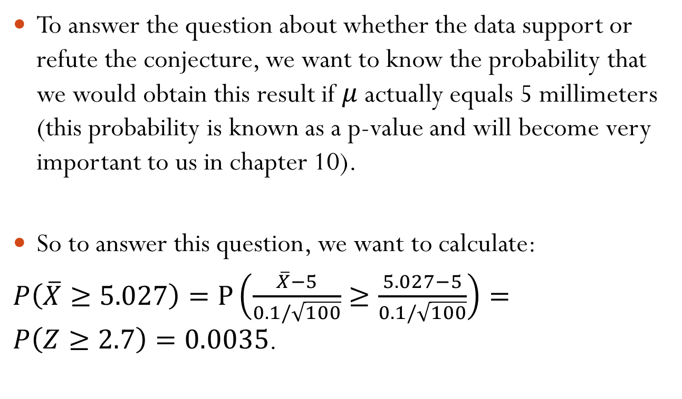
8.4 – Sampling Distribution of Means and the Central Limit Theorem
To answer the question about whether the data support or refute the conjecture, we want to know the probability that we would obtain this result if $μ$ actually equals 5 millimeters (this probability is known as a p-value and will become very important to us in chapter 10).
So to answer this question, we want to calculate:
$P\left(\overline{X}≥5.027\right)=P\left(\frac{\overline{X}−5}{0.1/\sqrt{100}}≥\frac{5.027−5}{0.1/\sqrt{100}}\right)=P\left(Z≥2.7\right)=0.0035$.

Slide 28

8.4 – Sampling Distribution of Means and the Central Limit Theorem
This tells us that if $μ$ were actually 5, only about 35 in every 10000 samples would give us as large of a sample mean $\left(5.027\right)$ as we actually saw. This can be interpreted as strong evidence that $μ$ is not actually 5.

Slide 29
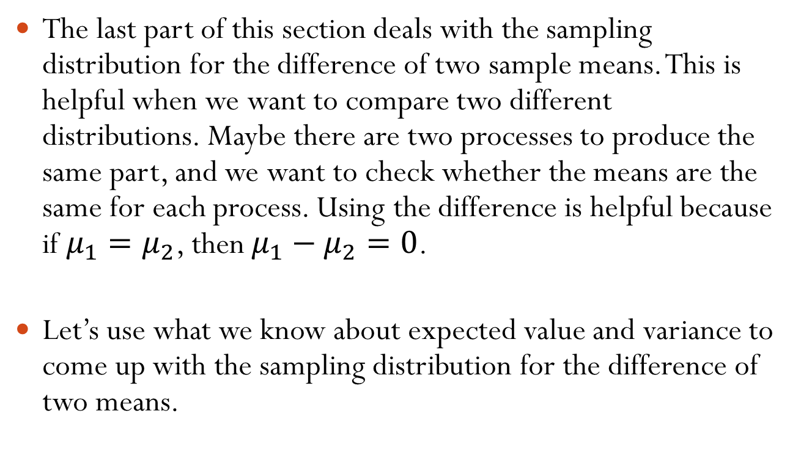
8.4 – Sampling Distribution of Means and the Central Limit Theorem
The last part of this section deals with the sampling distribution for the difference of two sample means. This is helpful when we want to compare two different distributions. Maybe there are two processes to produce the same part, and we want to check whether the means are the same for each process. Using the difference is helpful because if $μ_{1}=μ_{2}$, then $μ_{1}−μ_{2}=0$.
Let’s use what we know about expected value and variance to come up with the sampling distribution for the difference of two means.

Slide 30

8.4 – Sampling Distribution of Means and the Central Limit Theorem
Assume that we have two independent populations: $X_{i1}\sim N\left(μ_{1},σ_{1}^{2}\right)$ and $X_{j2}\sim N\left(μ_{2},σ_{2}^{2}\right)$. Assume that random samples of size $n_{1}$ and $n_{2}$ are drawn from each population. What is the mean of ${\overline{X}}_{1}−{\overline{X}}_{2}$? What is the variance?

Slide 31
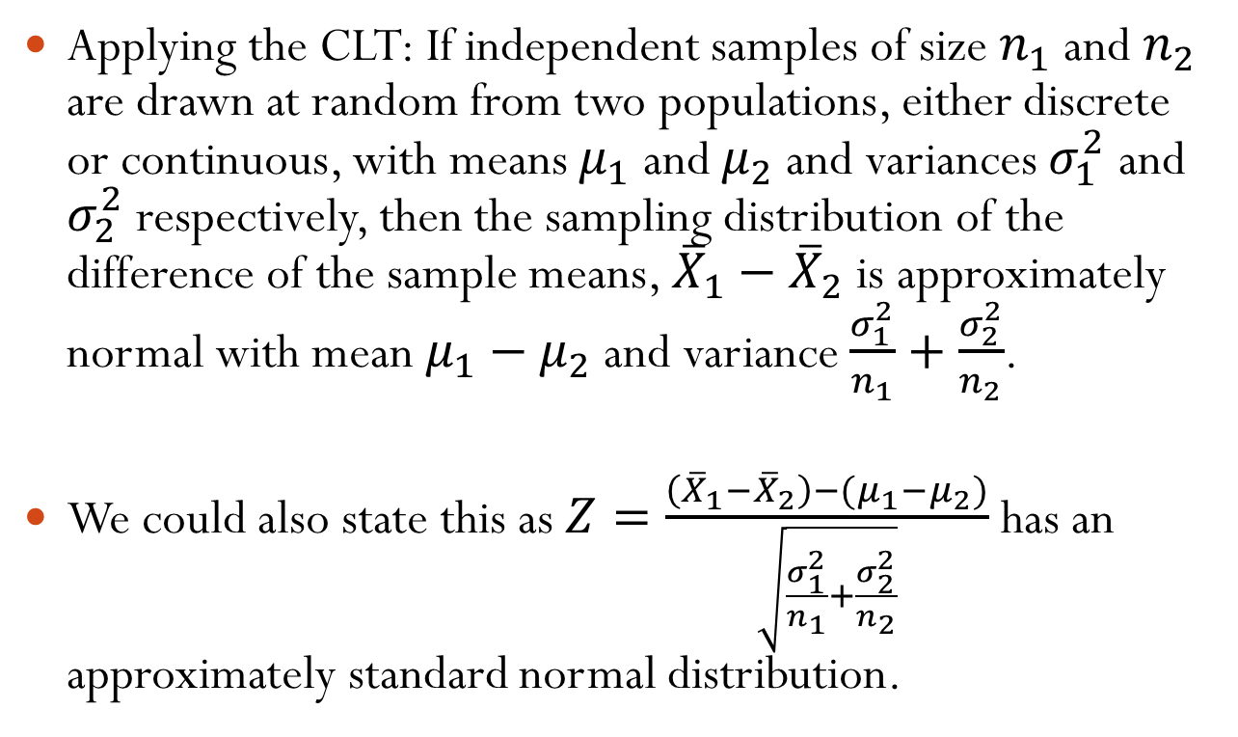
8.4 – Sampling Distribution of Means and the Central Limit Theorem
Applying the CLT: If independent samples of size $n_{1}$ and $n_{2}$ are drawn at random from two populations, either discrete or continuous, with means $μ_{1}$ and $μ_{2}$ and variances $σ_{1}^{2}$ and $σ_{2}^{2}$ respectively, then the sampling distribution of the difference of the sample means, ${\overline{X}}_{1}−{\overline{X}}_{2}$ is approximately normal with mean $μ_{1}−μ_{2}$ and variance $\frac{σ_{1}^{2}}{n_{1}}+\frac{σ_{2}^{2}}{n_{2}}$.
We could also state this as $Z=\frac{\left({\overline{X}}_{1}−{\overline{X}}_{2}\right)−{(μ}_{1}−μ_{2})}{\sqrt{\frac{σ_{1}^{2}}{n_{1}}+\frac{σ_{2}^{2}}{n_{2}}}}$ has an approximately standard normal distribution.

Slide 32
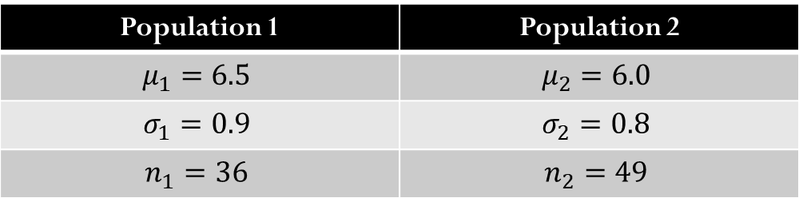
8.4 – Sampling Distribution of Means and the Central Limit Theorem
Example: Assume that we have two populations with the following information:
What is the probability that the difference (population 1 – population 2) in the sample means will be at least 1?
Population 1 | Population 2
$$μ_{1}=6.5$$ | $$μ_{2}=6.0$$
$$σ_{1}=0.9$$ | $$σ_{2}=0.8$$
$$n_{1}=36$$ | $$n_{2}=49$$

Slide 33

8.4 – Sampling Distribution of Means and the Central Limit Theorem
Given this information, we have ${\overline{X}}_{1}−{\overline{X}}_{2}=6.5−6=0.5$ and $σ_{{\overline{X}}_{1}−{\overline{X}}_{2}}=\sqrt{\frac{0.81}{36}+\frac{0.64}{49}}=0.189$. This implies that $z=\frac{1.0−0.5}{0.189}=2.65$ so that$P\left({\overline{X}}_{1}−{\overline{X}}_{2}≥1\right)=P\left(Z>2.65\right)=0.0040$.

Slide 34
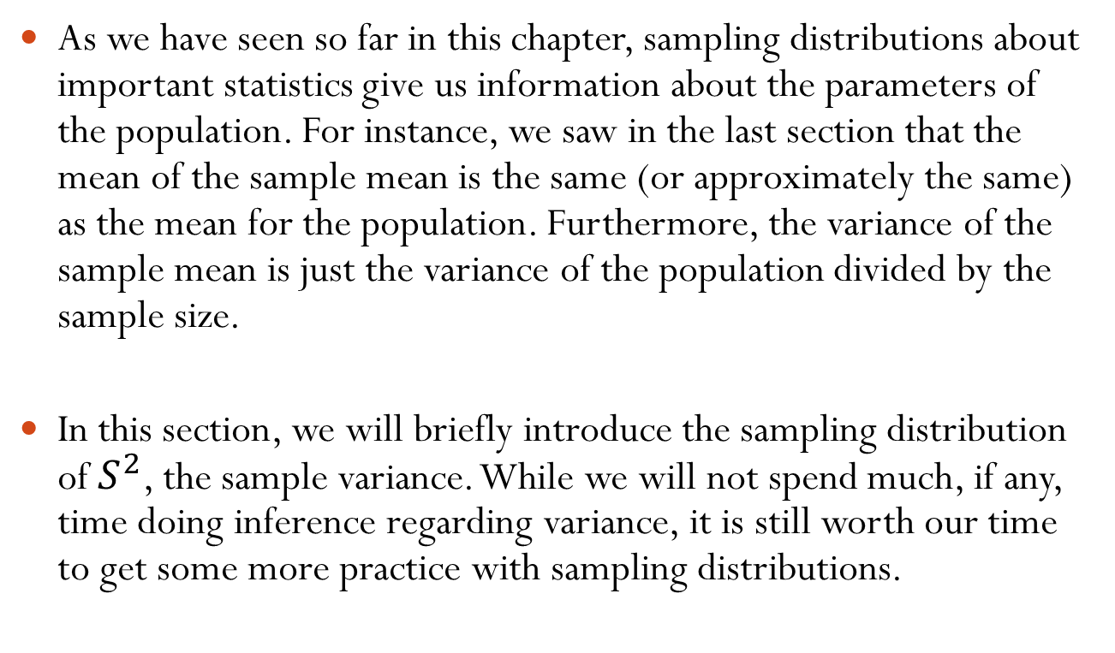
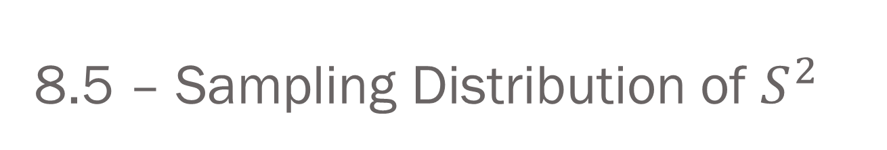
8.5 – Sampling Distribution of $S^{2}$
As we have seen so far in this chapter, sampling distributions about important statistics give us information about the parameters of the population. For instance, we saw in the last section that the mean of the sample mean is the same (or approximately the same) as the mean for the population. Furthermore, the variance of the sample mean is just the variance of the population divided by the sample size.
In this section, we will briefly introduce the sampling distribution of $S^{2}$, the sample variance. While we will not spend much, if any, time doing inference regarding variance, it is still worth our time to get some more practice with sampling distributions.

Slide 35
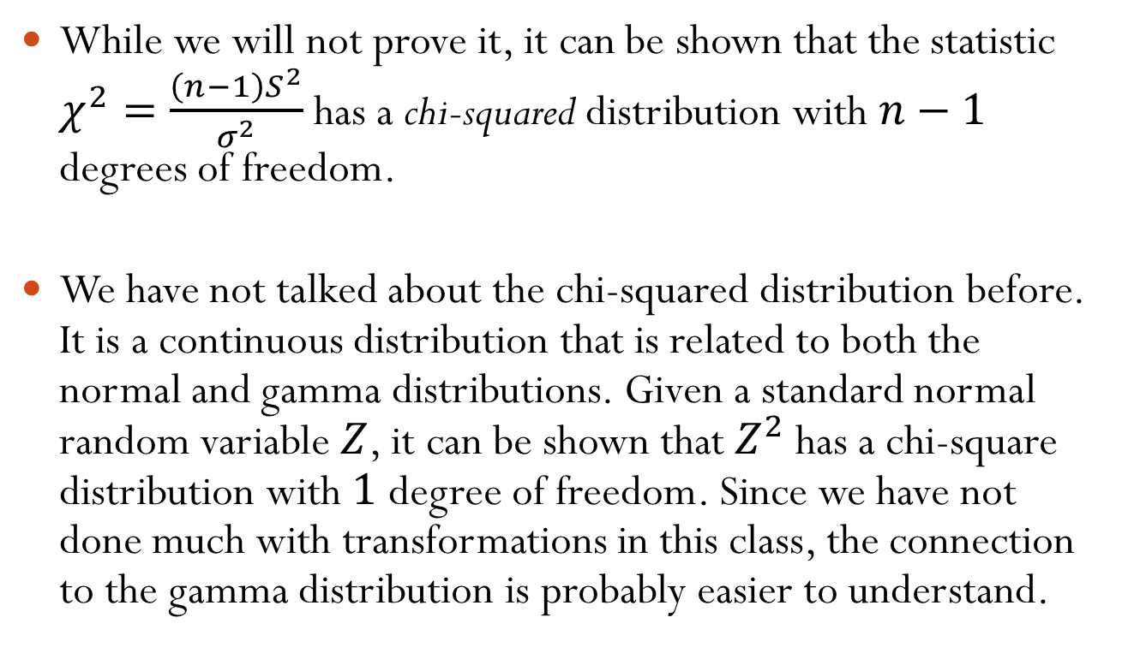
8.5 – Sampling Distribution of $S^{2}$
While we will not prove it, it can be shown that the statistic $χ^{2}=\frac{\left(n−1\right)S^{2}}{σ^{2}}$ has a chi-squared distribution with $n−1$ degrees of freedom.
We have not talked about the chi-squared distribution before. It is a continuous distribution that is related to both the normal and gamma distributions. Given a standard normal random variable $Z$, it can be shown that $Z^{2}$ has a chi-square distribution with $1$ degree of freedom. Since we have not done much with transformations in this class, the connection to the gamma distribution is probably easier to understand.

Slide 36
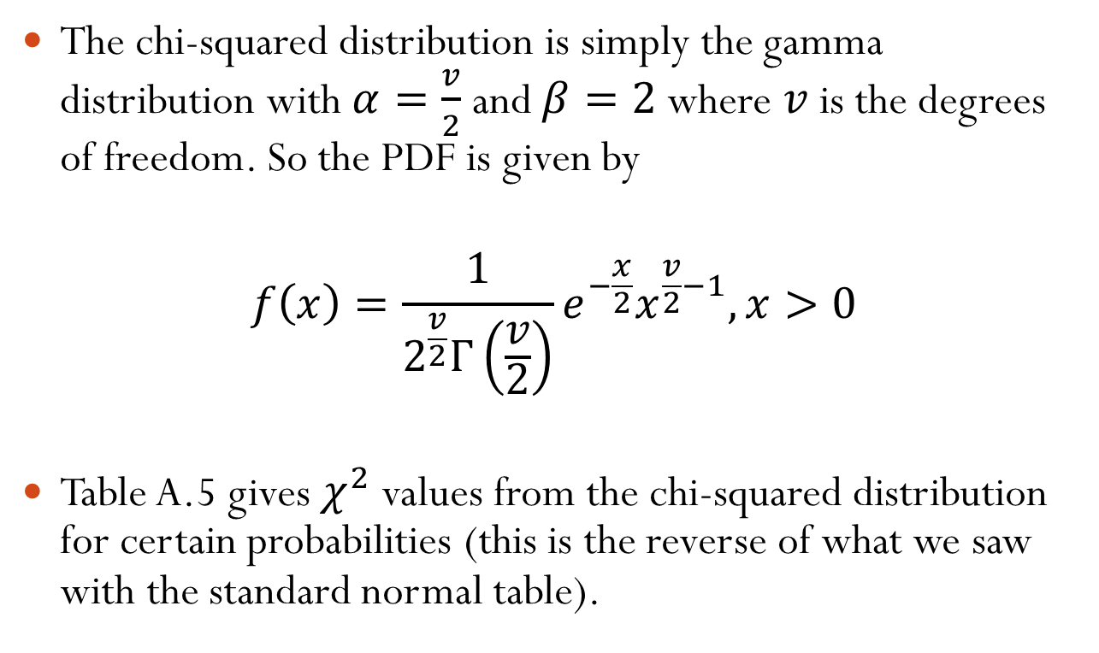
8.5 – Sampling Distribution of $S^{2}$
The chi-squared distribution is simply the gamma distribution with $α=\frac{v}{2}$ and $β=2$ where $v$ is the degrees of freedom. So the PDF is given by
$$f\left(x\right)=\frac{1}{2^{\frac{v}{2}}Γ\left(\frac{v}{2}\right)}e^{−\frac{x}{2}}x^{\frac{v}{2}−1}, x>0$$
Table A.5 gives $χ^{2}$ values from the chi-squared distribution for certain probabilities (this is the reverse of what we saw with the standard normal table).

Slide 37

8.5 – Sampling Distribution of $S^{2}$
A little bit of notation: we use $χ_{α}^{2}$ to denote the value above which we find an area of $α$ for a given chi-squared distribution.

Slide 38

8.5 – Sampling Distribution of $S^{2}$
Example (from 8.38 and 8.39 in the book):
  Find $χ_{0.05}^{2}$ when $v=19$
  Find $χ_{α}^{2}$ such that $P\left(37.652<X^{2}<χ_{α}^{2}\right)=0.045$ when $v=25$

Slide 39
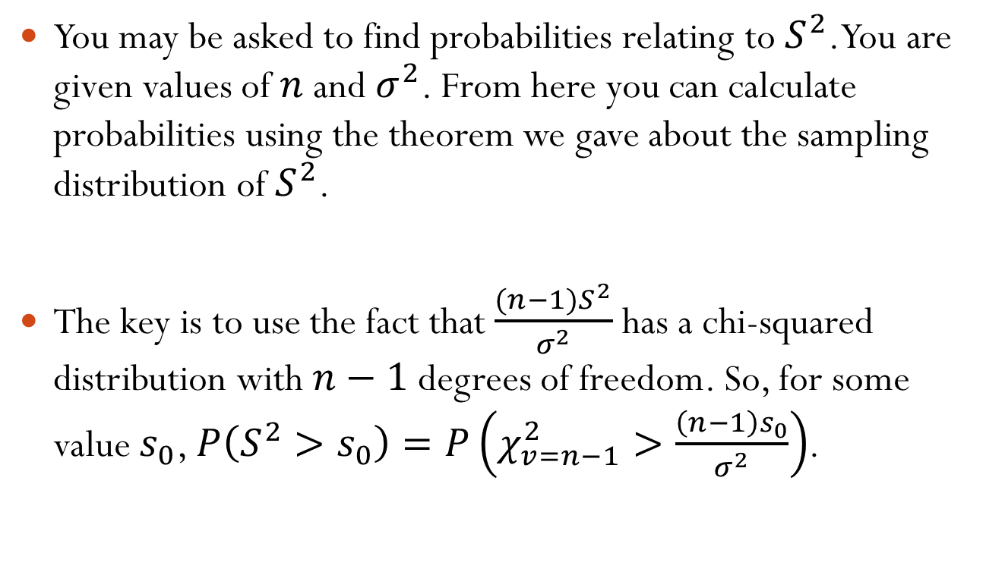
8.5 – Sampling Distribution of $S^{2}$
You may be asked to find probabilities relating to $S^{2}$. You are given values of $n$ and $σ^{2}$. From here you can calculate probabilities using the theorem we gave about the sampling distribution of $S^{2}$.
The key is to use the fact that $\frac{(n−1)S^{2}}{σ^{2}}$ has a chi-squared distribution with $n−1$ degrees of freedom. So, for some value $s_{0}$, $P\left(S^{2}>s_{0}\right)=P\left(χ_{v=n−1}^{2}>\frac{\left(n−1\right)s_{0}}{σ^{2}}\right)$.

Slide 40
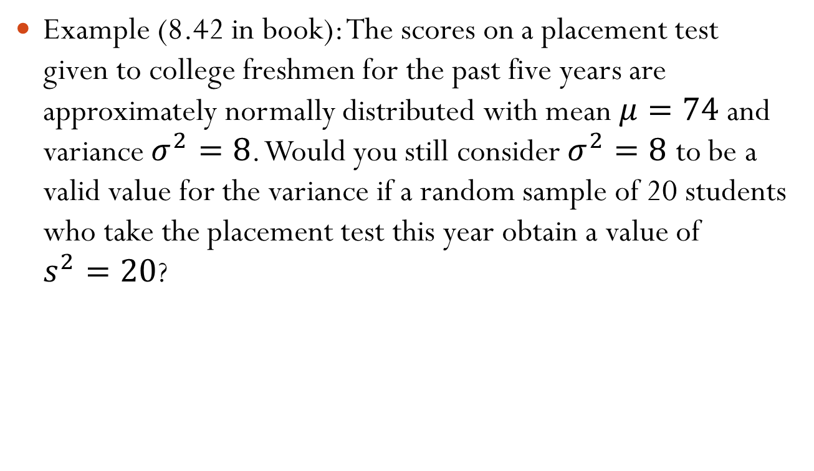
8.5 – Sampling Distribution of $S^{2}$
Example (8.42 in book): The scores on a placement test given to college freshmen for the past five years are approximately normally distributed with mean $μ=74$ and variance $σ^{2}=8$. Would you still consider $σ^{2}=8$ to be a valid value for the variance if a random sample of 20 students who take the placement test this year obtain a value of $s^{2}=20$?

Slide 41
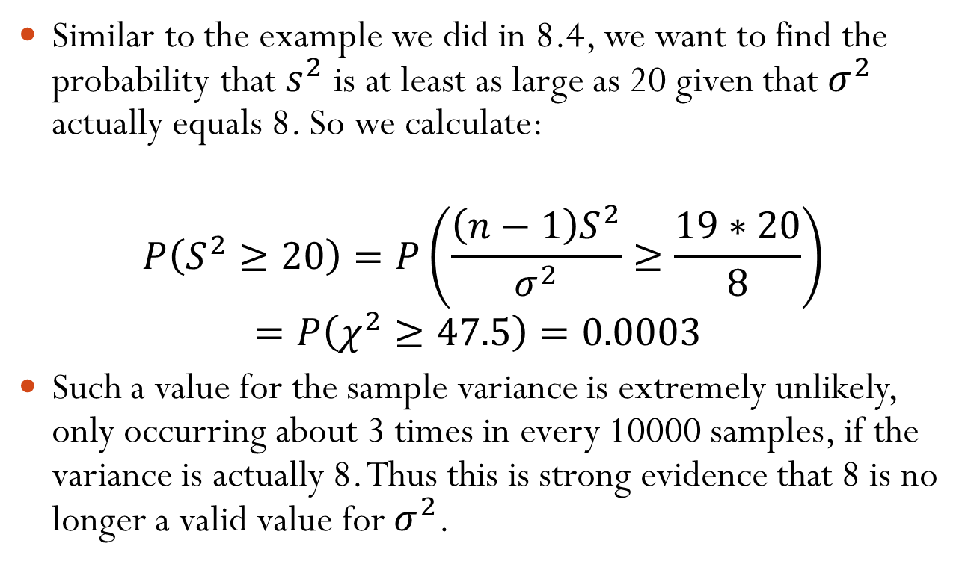
8.5 – Sampling Distribution of $S^{2}$
Similar to the example we did in 8.4, we want to find the probability that $s^{2}$ is at least as large as 20 given that $σ^{2}$ actually equals 8. So we calculate:
$$P\left(S^{2}≥20\right)=P\left(\frac{\left(n−1\right)S^{2}}{σ^{2}}≥\frac{19∗20}{8}\right)=P\left(χ^{2}≥47.5\right)=0.0003$$
Such a value for the sample variance is extremely unlikely, only occurring about 3 times in every 10000 samples, if the variance is actually 8. Thus this is strong evidence that 8 is no longer a valid value for $σ^{2}$.

Slide 42
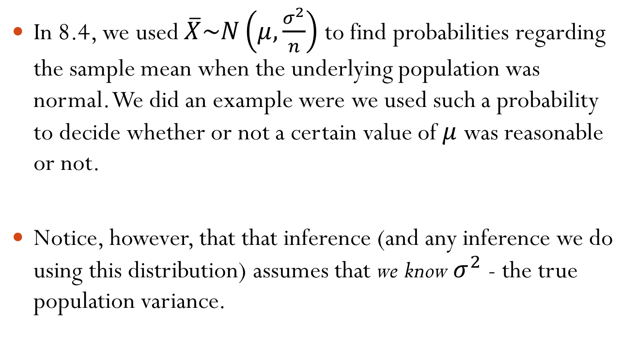
8.6 – The t-distribution
In 8.4, we used $\overline{X}\sim N\left(μ,\frac{σ^{2}}{n}\right)$ to find probabilities regarding the sample mean when the underlying population was normal. We did an example were we used such a probability to decide whether or not a certain value of $μ$ was reasonable or not.
Notice, however, that that inference (and any inference we do using this distribution) assumes that we know $σ^{2}$ - the true population variance.

Slide 43
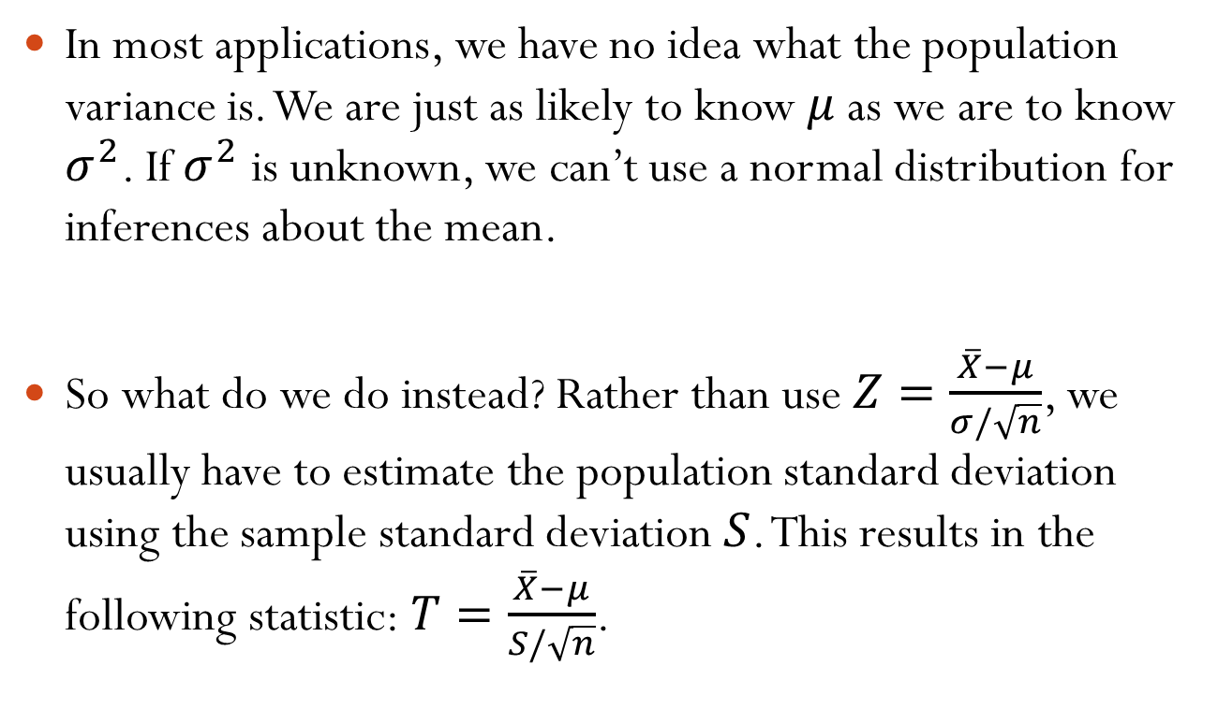
8.6 – The t-distribution
In most applications, we have no idea what the population variance is. We are just as likely to know $μ$ as we are to know $σ^{2}$. If $σ^{2}$ is unknown, we can’t use a normal distribution for inferences about the mean.
So what do we do instead? Rather than use $Z=\frac{\overline{X}−μ}{σ/\sqrt{n}}$, we usually have to estimate the population standard deviation using the sample standard deviation $S$. This results in the following statistic: $T=\frac{\overline{X}−μ}{S/\sqrt{n}}$.

Slide 44
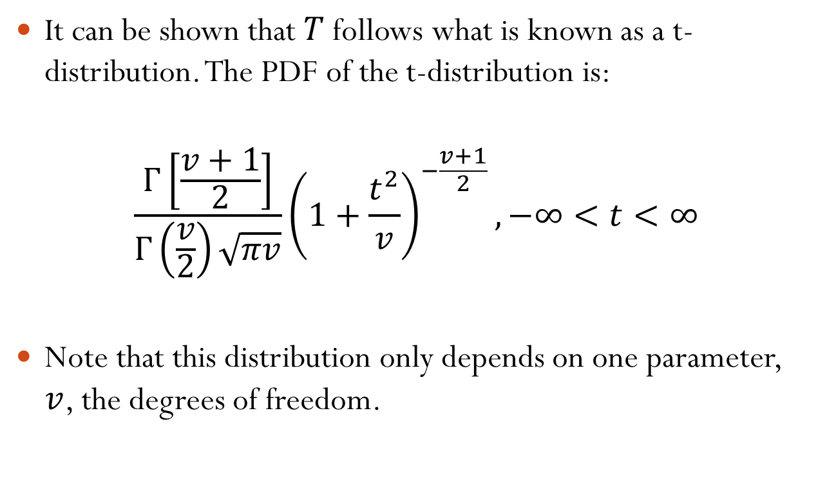
8.6 – The t-distribution
It can be shown that $T$ follows what is known as a t-distribution. The PDF of the t-distribution is:
$$\frac{Γ\left[\frac{v+1}{2}\right]}{Γ\left(\frac{v}{2}\right)\sqrt{πv}}{\left(1+\frac{t^{2}}{v}\right)}^{−\frac{v+1}{2}}, −∞<t<∞$$
Note that this distribution only depends on one parameter, $v$, the degrees of freedom.

Slide 45
8.6 – The t-distribution
The mean of the t-distribution is 0, regardless of the degrees of freedom. We won’t worry about the variance of the t-distribution. We are mostly concerned with when and how to use it.
The next slides have plots of several t-distributions. These illustrate the effect that the parameter has on the distribution as well as the relationship between the t-distribution and the standard normal distribution.

Slide 46
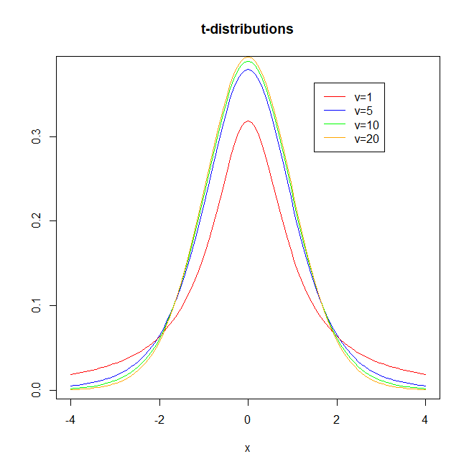
8.6 – The t-distribution

Slide 47
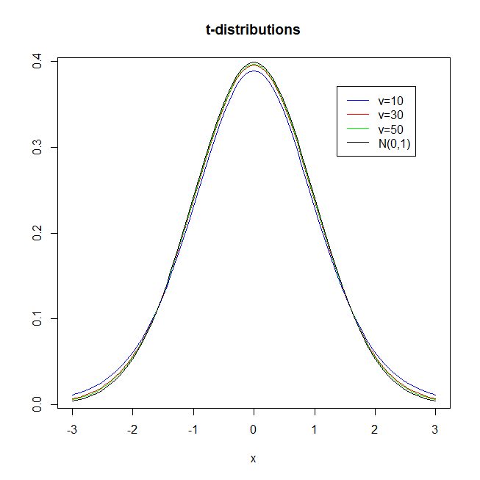
8.6 – The t-distribution

Slide 48
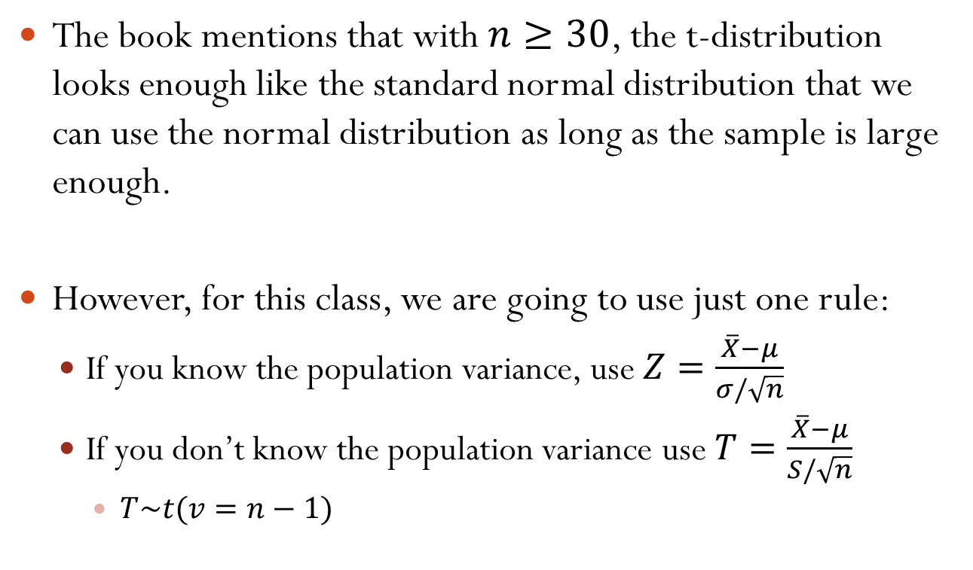
8.6 – The t-distribution
The book mentions that with $n≥30$, the t-distribution looks enough like the standard normal distribution that we can use the normal distribution as long as the sample is large enough.
However, for this class, we are going to use just one rule:
  If you know the population variance, use $Z=\frac{\overline{X}−μ}{σ/\sqrt{n}}$
  If you don’t know the population variance use $T=\frac{\overline{X}−μ}{S/\sqrt{n}}$
    $T\sim t(v=n−1)$

Slide 49
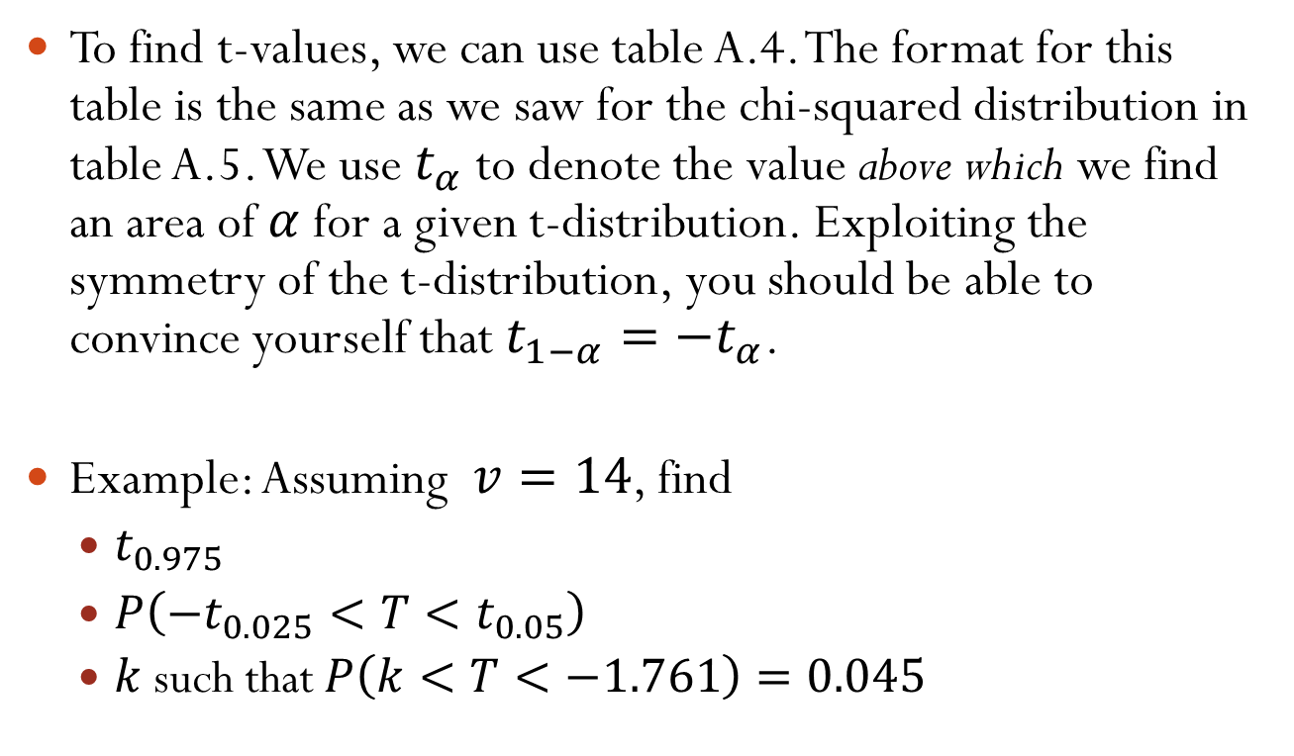
8.6 – The t-distribution
To find t-values, we can use table A.4. The format for this table is the same as we saw for the chi-squared distribution in table A.5. We use $t_{α}$ to denote the value above which we find an area of $α$ for a given t-distribution. Exploiting the symmetry of the t-distribution, you should be able to convince yourself that $t_{1−α}=−t_{α}$.
Example: Assuming $v=14$, find
  $t_{0.975}$
  $P\left(−t_{0.025}<T<t_{0.05}\right)$
  $k$ such that $P\left(k<T<−1.761\right)=0.045$

Slide 50
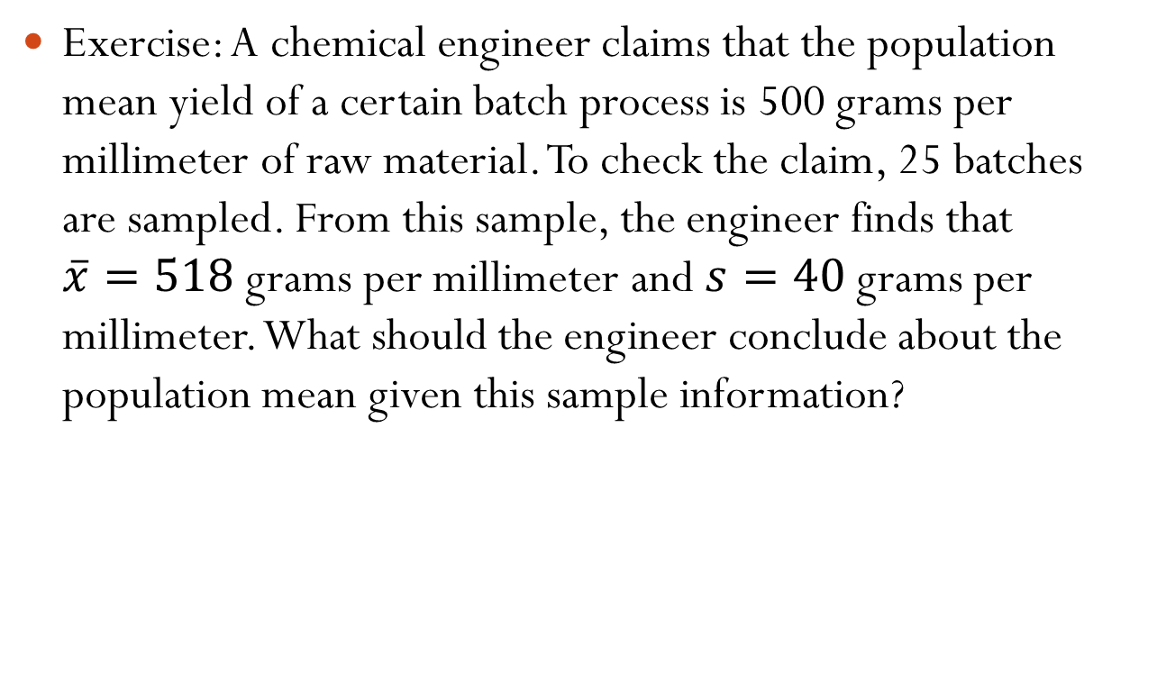
8.6 – The t-distribution
Exercise: A chemical engineer claims that the population mean yield of a certain batch process is 500 grams per millimeter of raw material. To check the claim, 25 batches are sampled. From this sample, the engineer finds that $\overline{x}=518$ grams per millimeter and $s=40$ grams per millimeter. What should the engineer conclude about the population mean given this sample information?

Slide 51
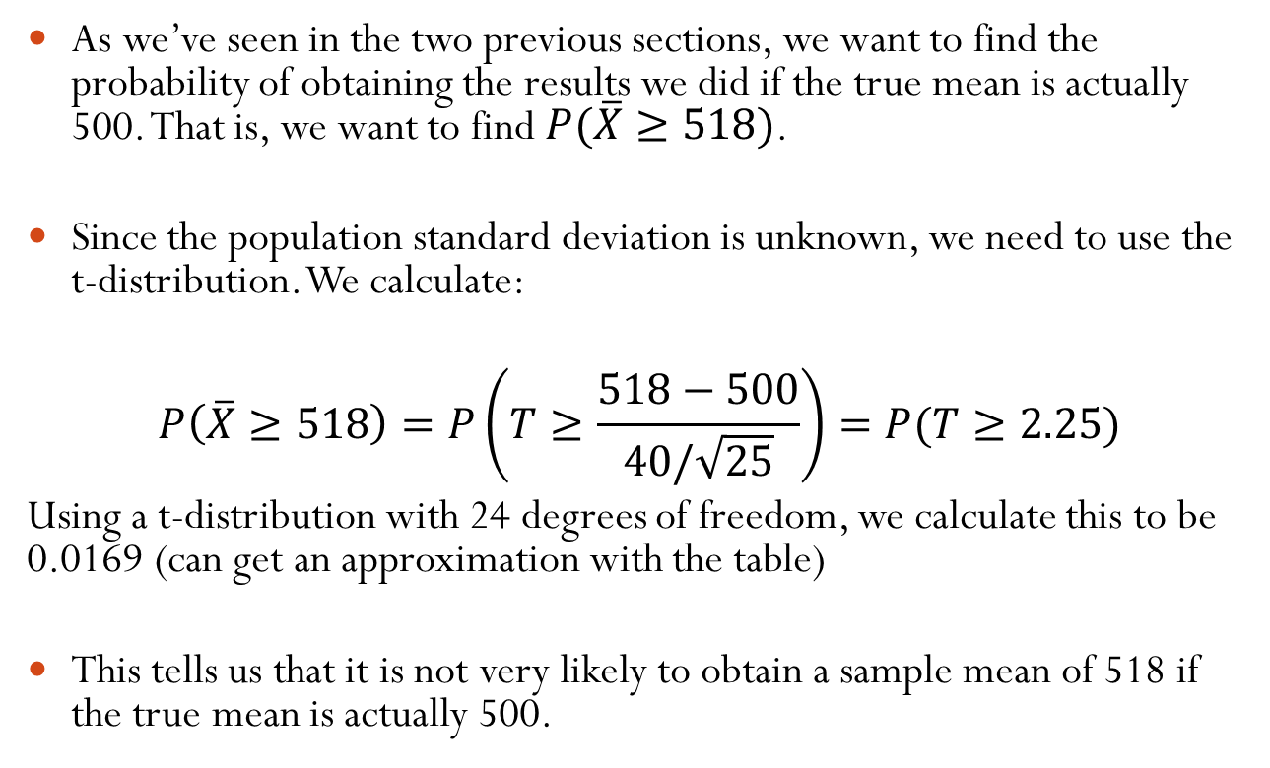
8.6 – The t-distribution
As we’ve seen in the two previous sections, we want to find the probability of obtaining the results we did if the true mean is actually 500. That is, we want to find $P(\overline{X}≥518)$.
Since the population standard deviation is unknown, we need to use the t-distribution. We calculate:
$$P\left(\overline{X}≥518\right)=P\left(T≥\frac{518−500}{40/\sqrt{25}}\right)=P(T≥2.25)$$
Using a t-distribution with 24 degrees of freedom, we calculate this to be 0.0169 (can get an approximation with the table)
This tells us that it is not very likely to obtain a sample mean of 518 if the true mean is actually 500.

Slide 52
8.6 – The t-distribution
One important thing to be aware of: to use the t-distribution, the underlying population needs to be normal (or approximately normal). For this reason you will often see problems state “assume the population is normal” (or approximately normal).

